Slide 1
Vacation Spot Development & Property Renting.
Vikas Kumbhar , Rushikesh Kadam,
Suraj Bavdekar , Prasad Shinde.
By :-

Slide 2

WHY ?
In our College days we all face Different problems , different stress And when things come to enjoy college days or enjoy the some memorable days.
We plan a trip with our close ones
But…
The Plan is sometime get cancel like “Goa trip” every one have this experience once in life of GOA PLAN CANCEL in our life due to small reasons, so when things come to decide our e-DAC project subject we decide to build a web site for make those trips more easy and weekends plan more comfortable to decide where and when we want to go and where we can stay…

Slide 3

CONCEPT
Our Project is based on PDCA which is stands for Plan Do Check Act. The concept of our project is simple, we are here to give the platform to Plan the vacation, Do take a single minute to decide vacation spot, Check the nearby property for stay, Act without worries & enjoy the vacation.

Slide 4
OBJECTIVE
The objective of this project is to develop vacation spots and give an opportunity to the people to level up their livelihood by renting their property for visitors to stay. All this are happening on single platform by just one web site/ application where visitors or the people who want to make their vacation worriless and make stay at their vacation spot by renting nearby personal property, it can be done from the comfort of home through the Internet

Slide 5
IMPLEMENTATION TECHNOLOGIE
The system is implemented using MERN stack approach
MongoDB
Express
React
Node.js

Slide 6
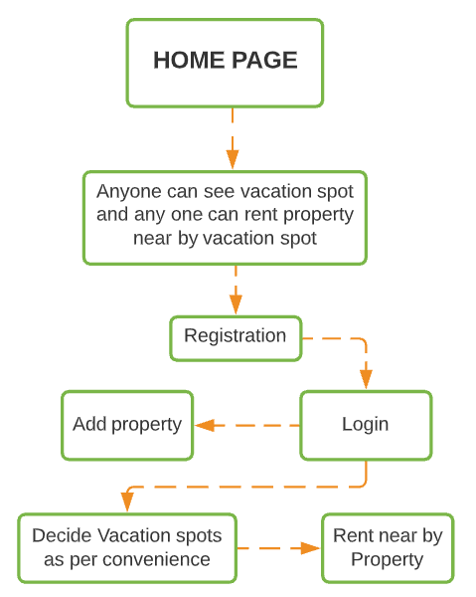
FLOW

Slide 7
MODULE
Iterative Model :
In this Model, you can start with some of the software specifications and develop the first version of the software. After the first version if there is a need to change the software, then a new version of the software is created with a new iteration. Every release of the Iterative Model finishes in an exact and fixed period that is called iteration
Why Iterative Model ?
We have clarity about our requirements.
It is easy to understand.
We know software application is going to be large.
And not but not least the requirement are going to be changes in future.

Slide 8
FUTURE SCOPE
User can directly do the payment to as he/she booked the property for renting as per property owner decided by online payment method.
Top most visited spots and properties are sorted as per their review and ratings

Slide 9
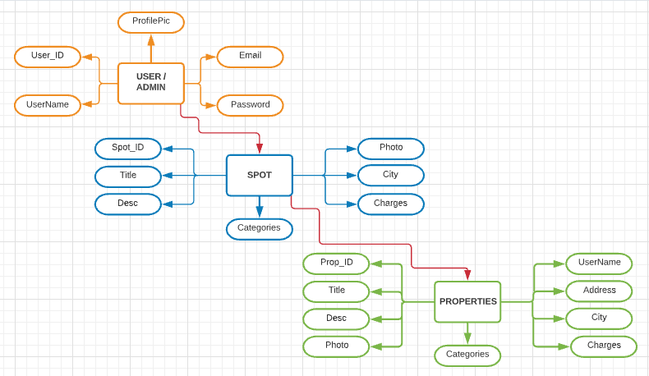
Database Tables

Slide 10
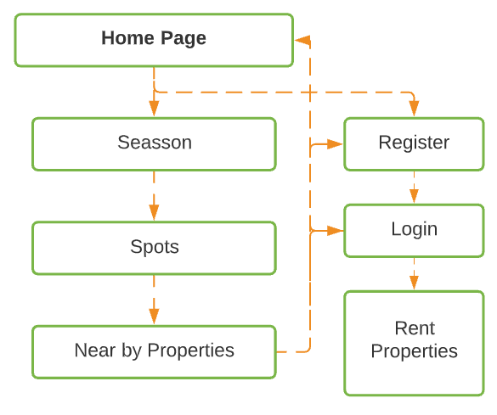
Web Site

Slide 11

Thank You

